Slide 1
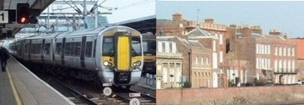
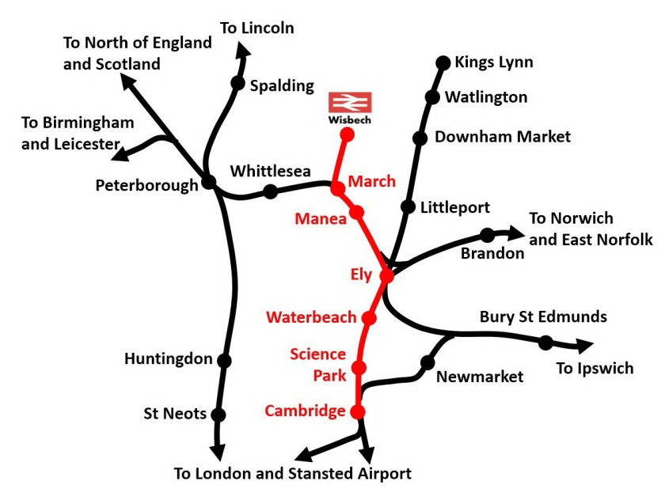
Wisbech Rail Reopening Campaign
Campaigning to reopen the railway from Wisbech to March and on to Cambridge
Feasibility studies in progress by Cambridgeshire County Council
But the project needs good local support
Please sign the petition at wisbechrail.org.uk
Leading the Wisbech Rail Reopening Campaign

Slide 2
Wisbech Rail Reopening Campaign
Please sign the petition at wisbechrail.org.uk
Leading the Wisbech Rail Reopening Campaign

